Slide 1

Who is the best NBA player? Michael, Kobe, or Lebron?3
Qingqing Hu, DeAndre Thomas, Brayan Quezada, Jon Burgess
Notes:
Hello, This is IST 718 Big Data Analytics, instructed by Professor Jill Lando. Today, Qingqing, Brayan, Jon, and I will be discussing Who is the best NBA Player out of Michael Jordan, Kobe Bryant, and Lebron James.

Slide 2
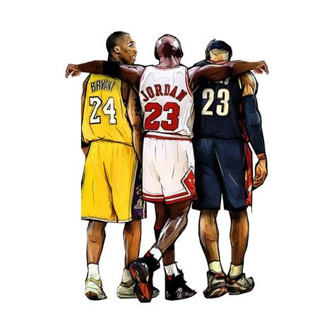
Introduction
Every player in the modern NBA is always compared to Michael Jordan, who is presumed to be the greatest basketball player of all time.
The goal of our project is two-fold. We want to determine if Michael is still the G.O.A.T or do Kobe and Lebron have an argument to pass him. We also want to look at the collective body of work these three players have done the Finals and see if we can identify which factors or stats have the biggest impact on winning the NBA Championship.
While many comparisons between the three are possible, we chose to focus on NBA Finals performances.
Notes:
Every basketball player and lover in the world has idolized Michael Jordan. To many, if not most, he is the greatest player of all time. In our project, we wanted to answer the long standing question of if MJ is, in fact, the greatest of all time, or does Kobe Bryant and Lebron James have seat at the table when discussing the topic of who is truly the greatest.
Additionally, we wanted to identify what attributes of a NBA player have the biggest impact on winning a NBA Championship.
Please Note: While many comparisons between the three are possible, we chose to focus on NBA Finals performances.

Slide 3
About the Data
The data we used was from Kaggle. (https://www.kaggle.com/xvivancos/michael-jordan-vs-kobe-bryant-vs-lebron-james)
While many different data sets are included in this kaggle release, we focused mainly on the all-stats csv, which had every single game the three players played and all associated statistics with them.
We scraped the dates of NBA finals games which we used as a filter for the data. This allowed us to analyze only the NBA finals games to identify which stats, if any, play the most significant role to decide a Championship.
While no model will be able to tell us who is the best, we hope that by our analysis of the statistics around the championships and what is important in the wins and losses that we may glean insight on who performed to this threshold the most consistently.
Notes:
There were a total of 7 CSVs that Kaggle provided with data on Jordan, Bryant, and James, we decided to focus on their “all game stats’. This dataset contains 29 columns, and 4,255 rows.
We also scraped NBA Finals Dates from the web so that we can filter the data set, and identify and analyze the stats to decide which played the most significant role in winning in a series.
While no model will be able to tell us who is the best, we hope that by our analysis of the statistics around the championships and what is important in the wins and losses that we may glean insight on who performed to this threshold the most consistently.

Slide 4
Specifications
What attributes constitute an NBA Champion?
Who has been the most impactful NBA player?

Slide 5
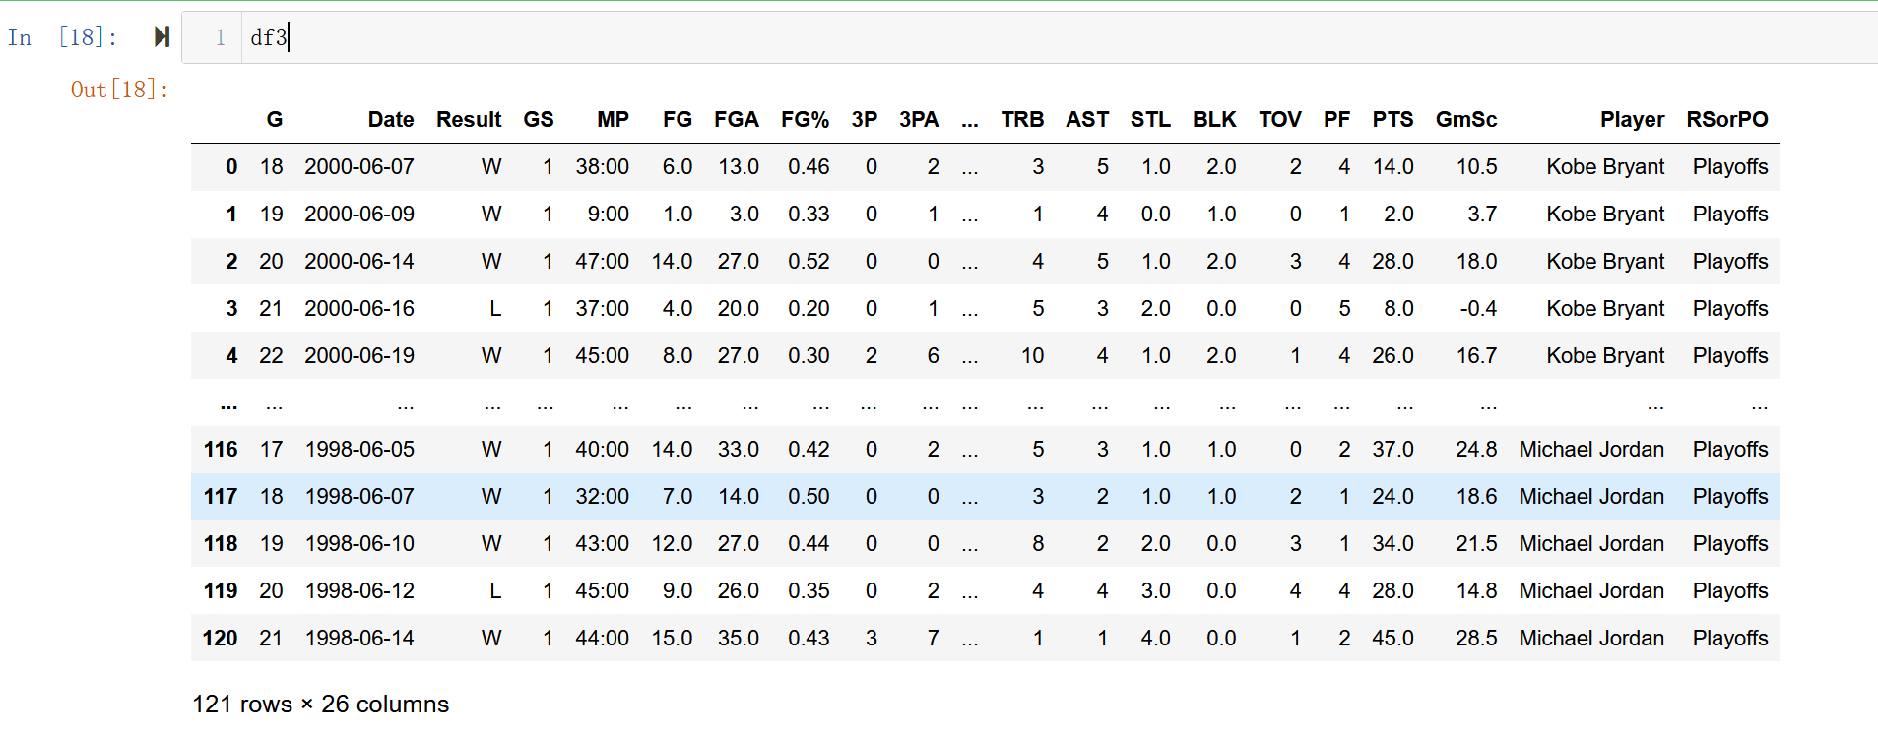
Observation --- NBA Finals Dataset

Slide 6
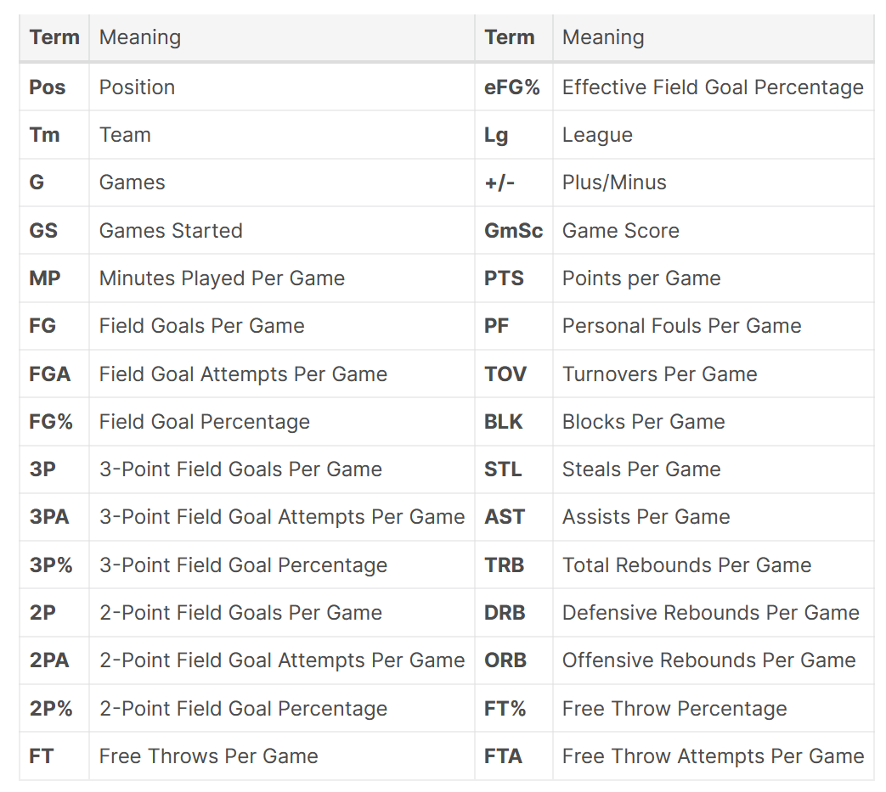
Observation--- Simple Parameters in the Dataset

Slide 7
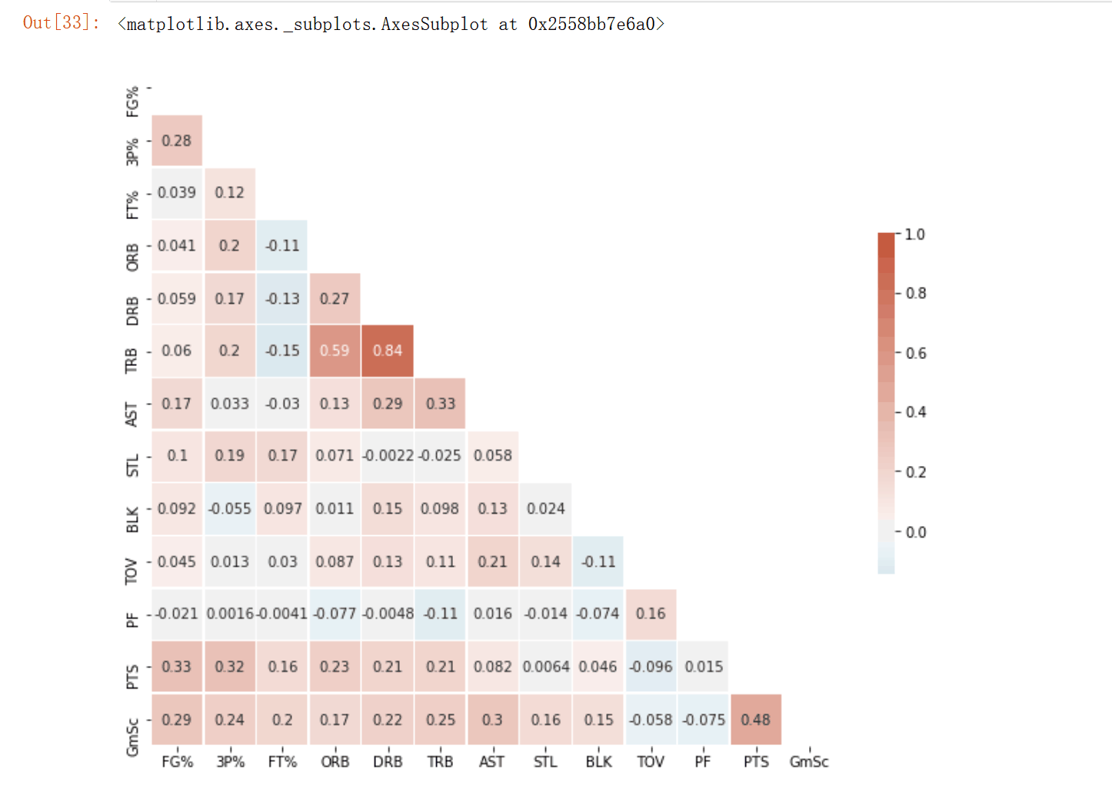
Observation---Correlation

Slide 8
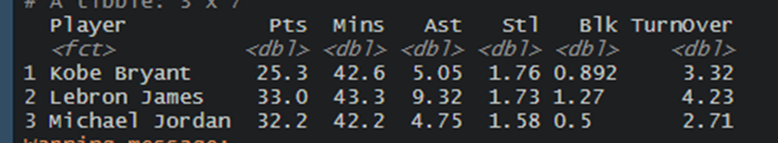
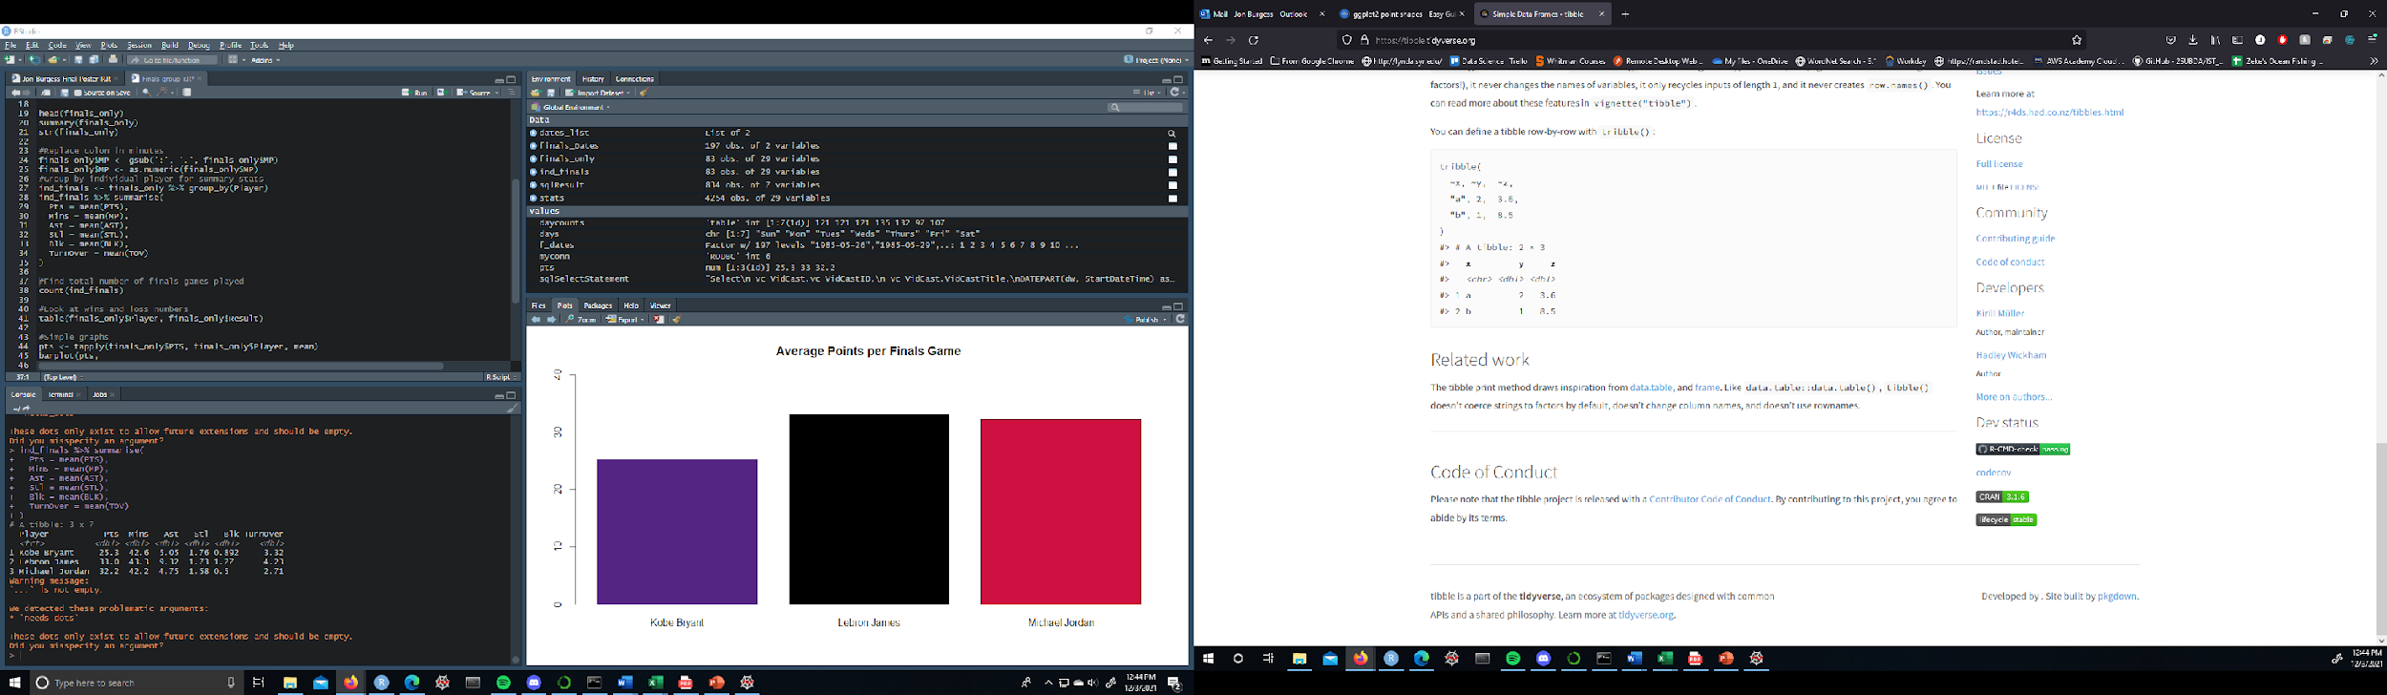
Observation---Summary Data

Slide 9
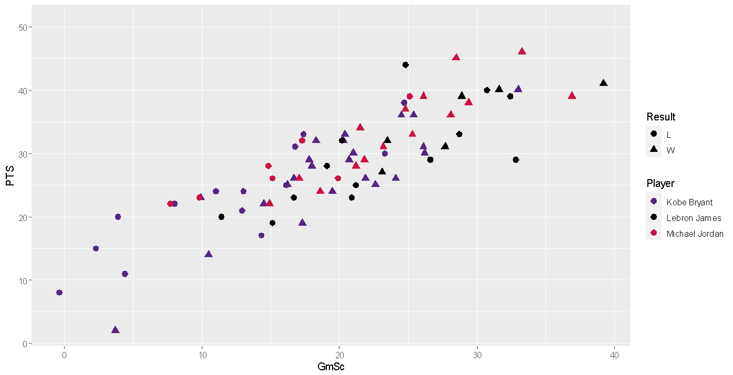
Observation---Overall

Slide 10
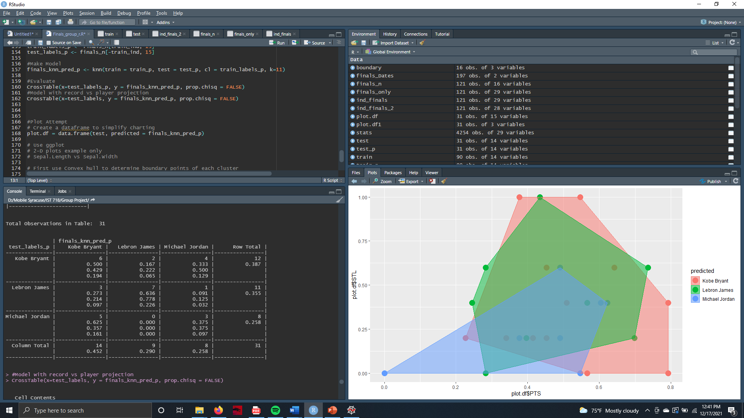
Analysis and Models---k-Nearest Neighbors
By running a kNN model we hope to verify the impact of the stats to wins and losses by the three players. All continuous variables were normalized so not to overpower the model. The first kNN model we created was to try and validate the accuracy of the algorithm by predicting each player.
The model seemed to predict Kobe and Lebron well enough but had a more difficult time with Michael. The small test set could have something to do with this result.

Slide 11
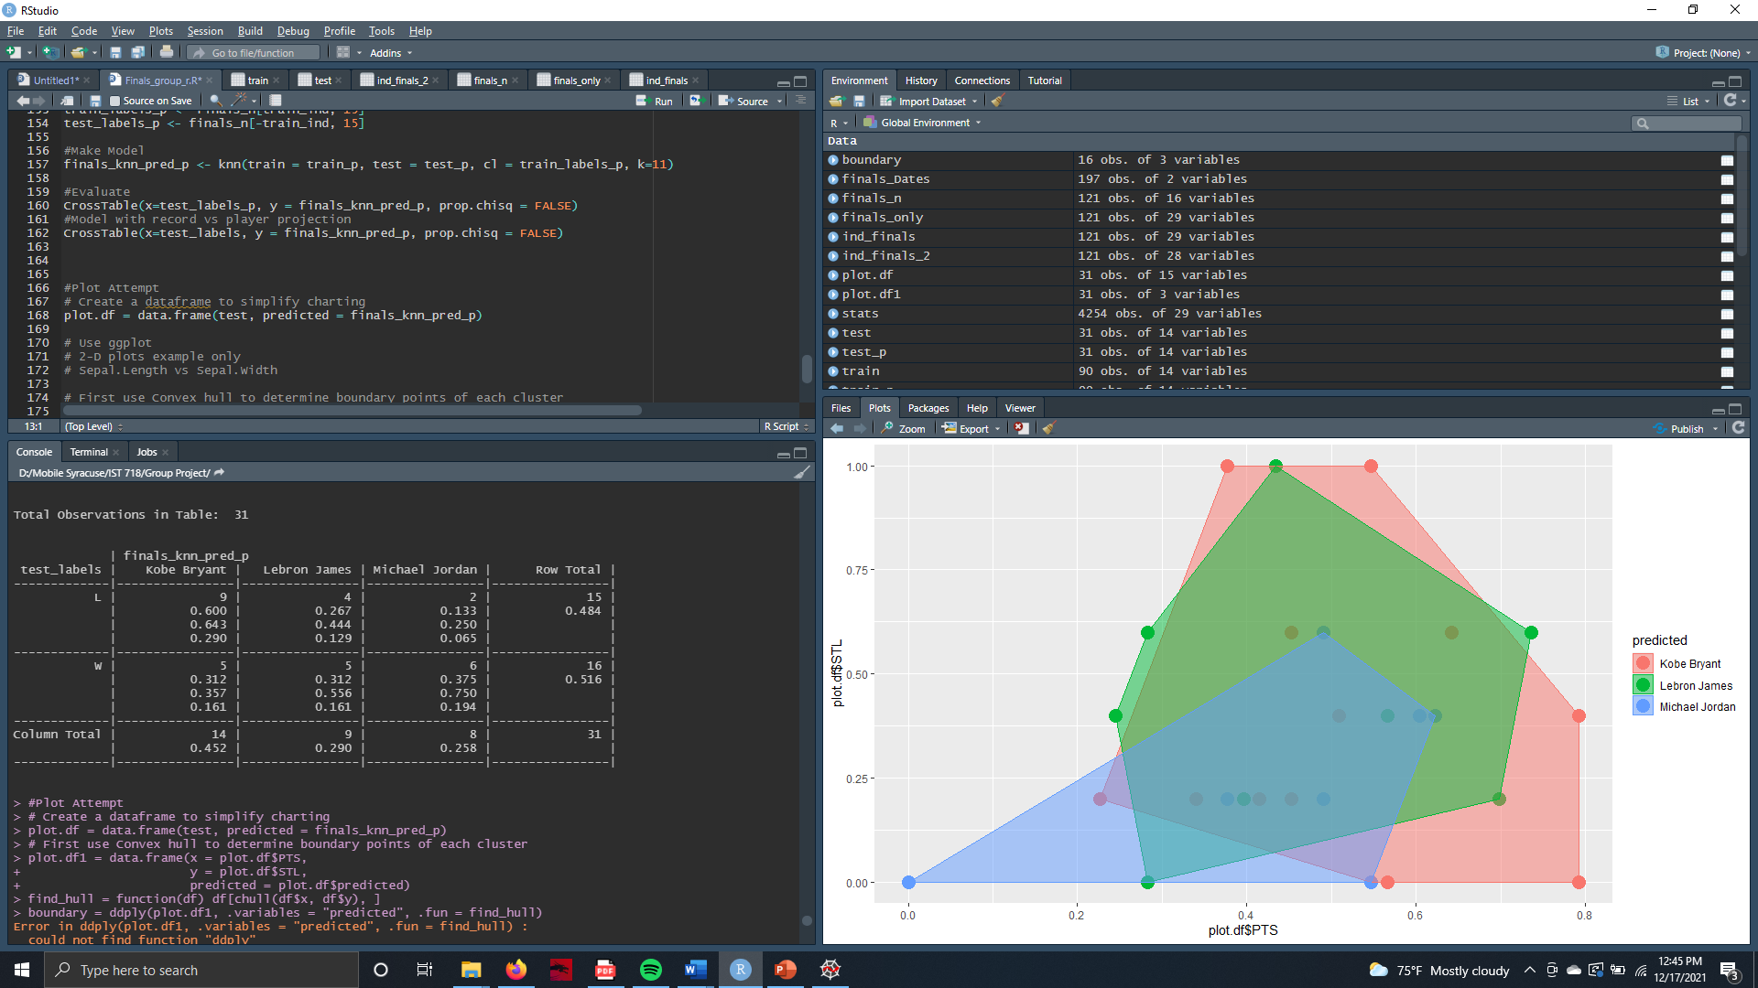
Analysis and Models---k-Nearest Neighbors
The second model attempted to classify each player by wins and losses. Michael Jordan had the best ratio of 3:1 wins to losses while Lebron was 5:4 and Kobe was 5:9 wins:losses.
These results confirm one popular statement that man fans use to support Michael as the greatest ever, noting his perfect 6 titles in 6 appearances. Lebron and Kobe both played in multiple championship series and lost, lowering their record overall.

Slide 12
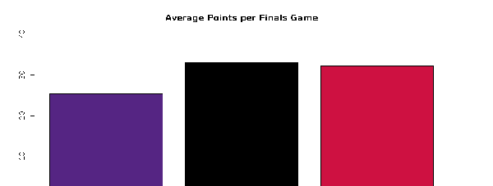
Analysis and Models---Average points per game 2
Lebron and Jordan performed relatively well, with the former having an average score of more than 30 and the latter having an average score of close to 30. Kobe's average score per game is close to 25.

Slide 13
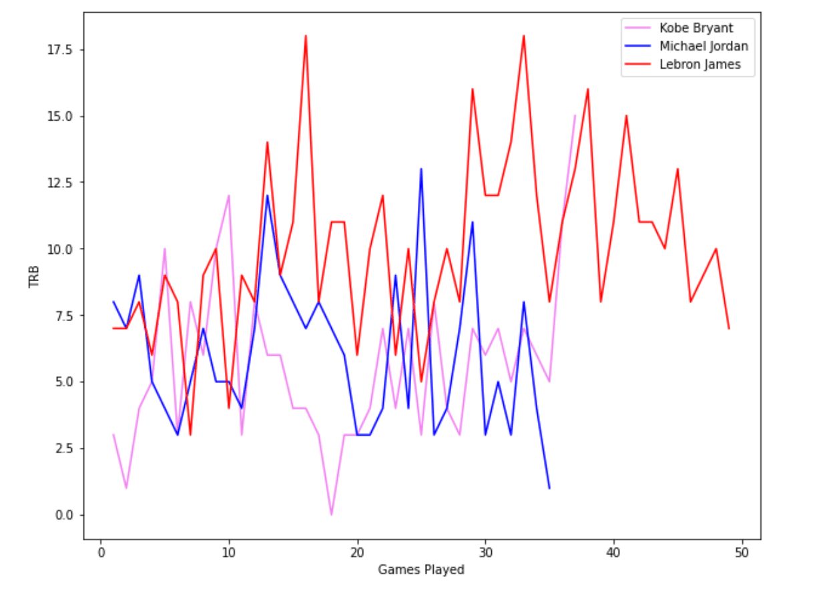
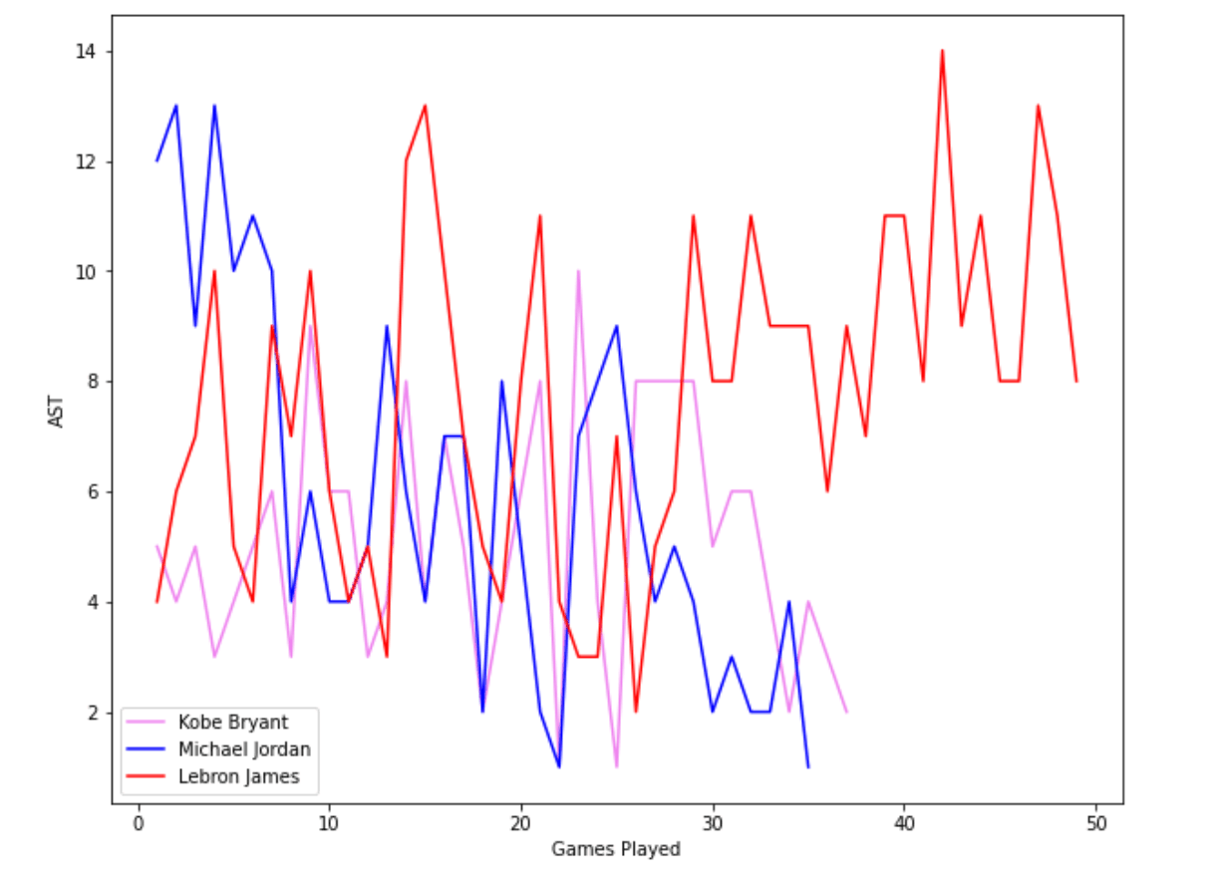
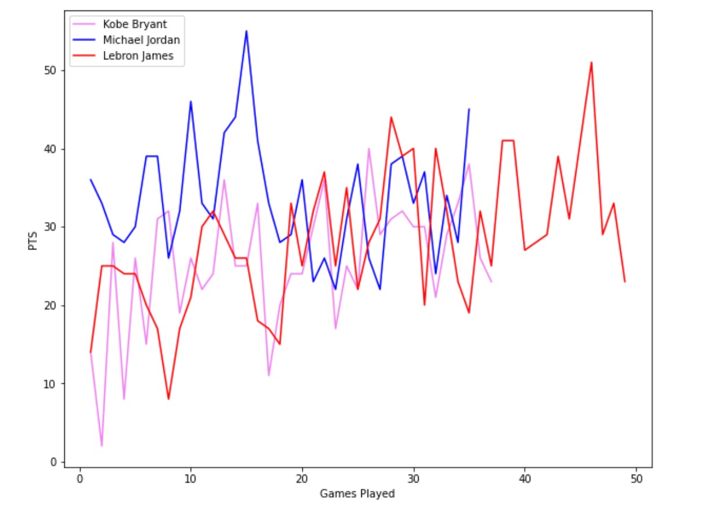
Analysis and Models---TRB/AST/PTS 2
Lebron performed better in Rebound and Assist and Points in all NBA finals.
Kobe has a relative stable state on TRB, AST and PTS.
Jordan scored higher in the early game, and his performance showed a downward trend in the late game on AST.

Slide 14
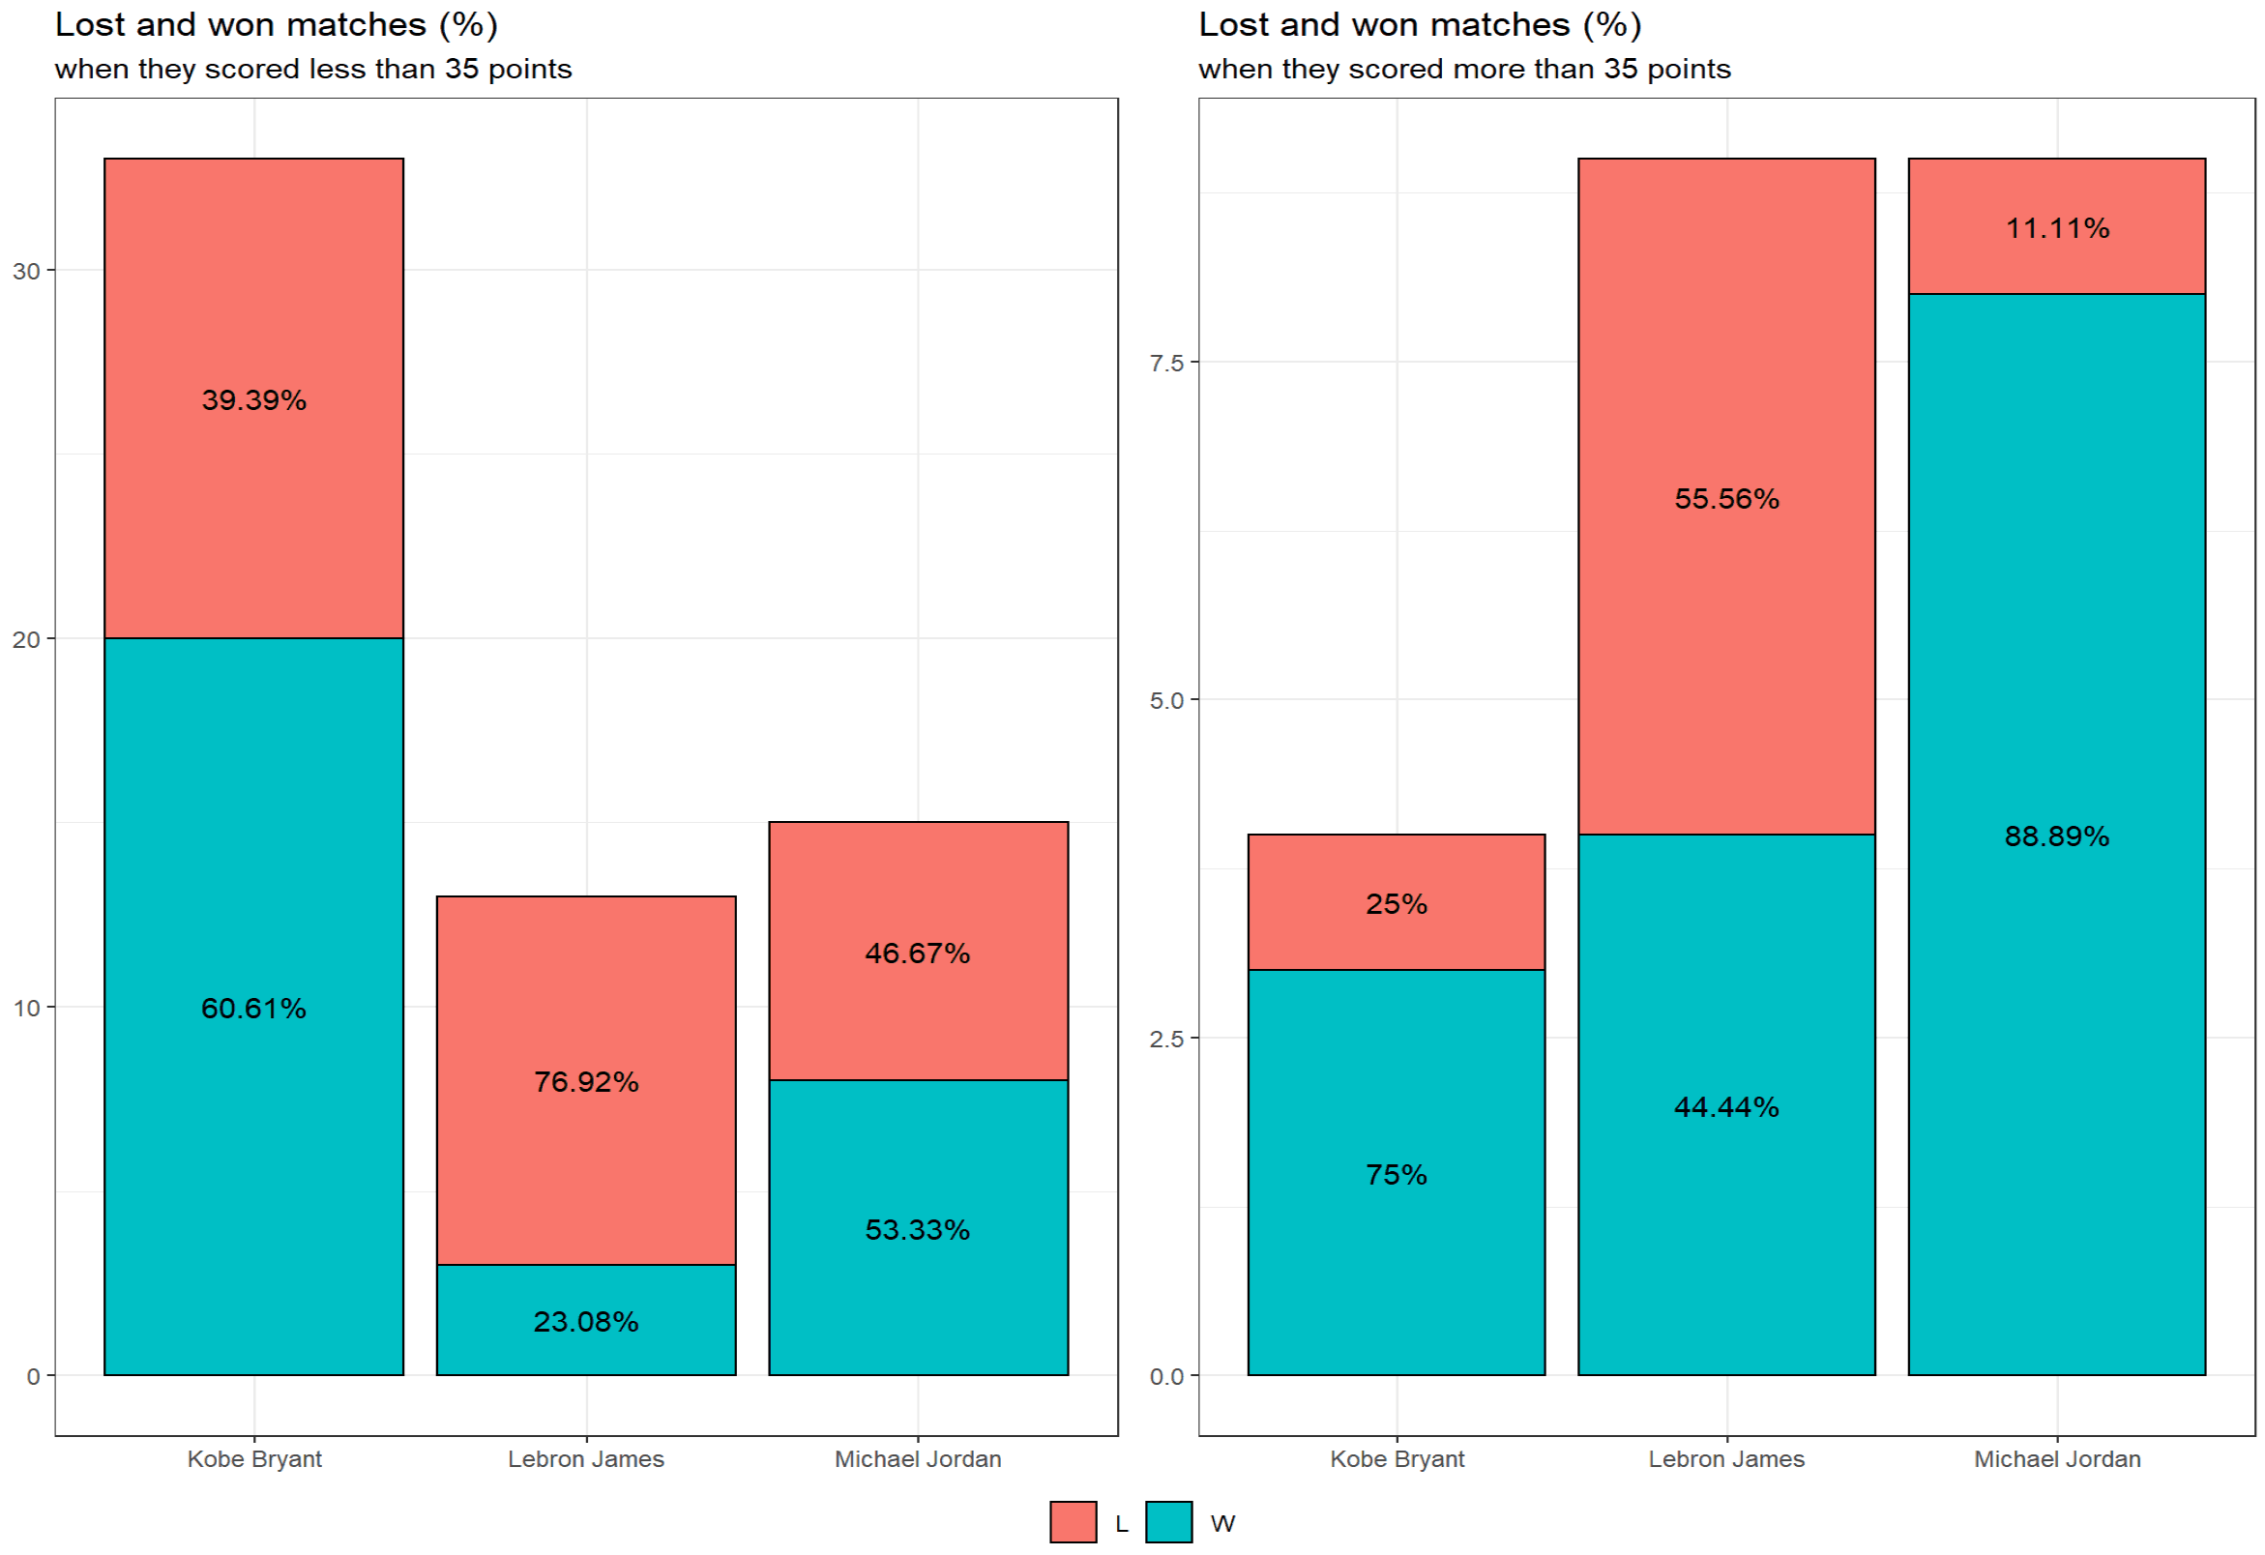
Analysis and Models---Dependency
Personal points : <35 & >=35
As Lebron and Jordan performed better (points > 35), the probability of getting win by their teams greatly increased. In other words, they made a greater contribution to the result of the game.
However, the cooperation between Kobe and his teammates is more critical to the victory of the game.

Slide 15
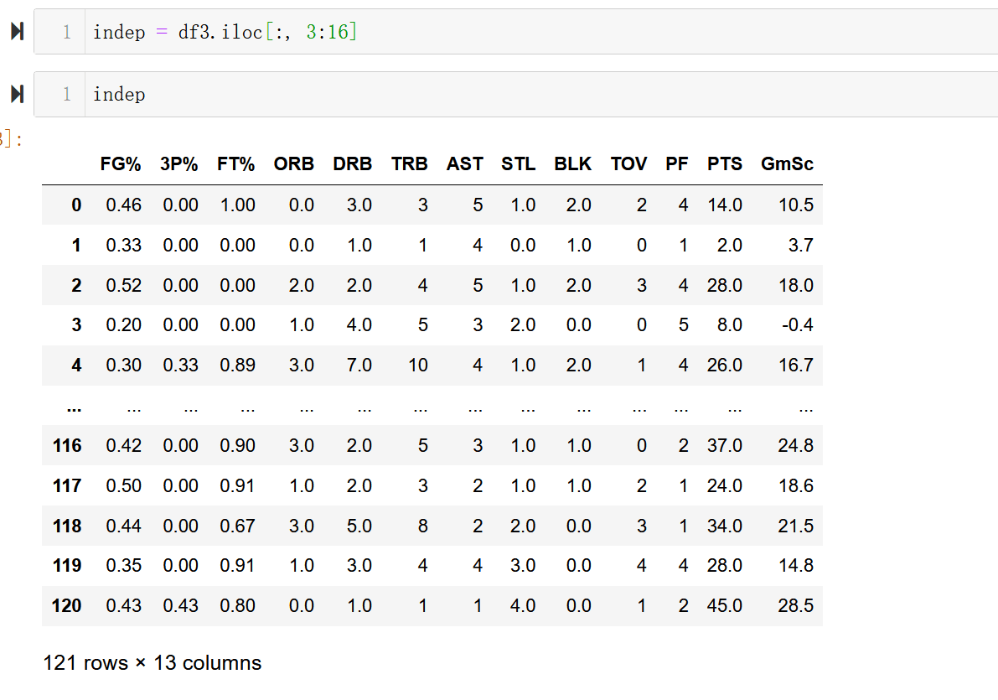
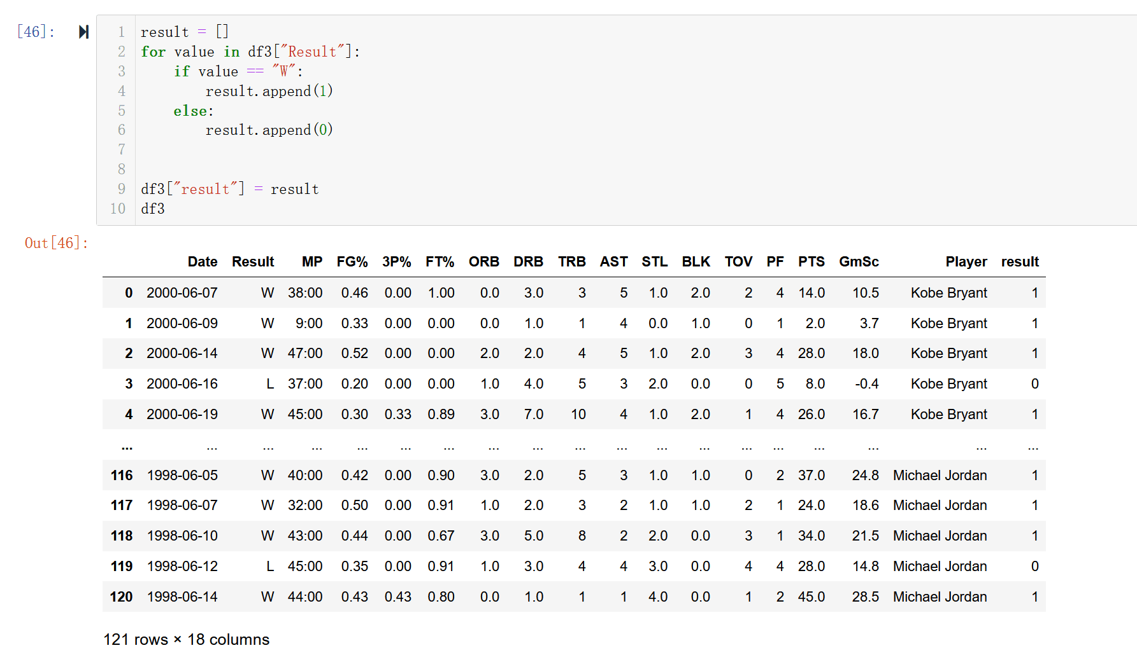
Analysis and Models 2
Independent Variables:
Processed Dataset:

Slide 16
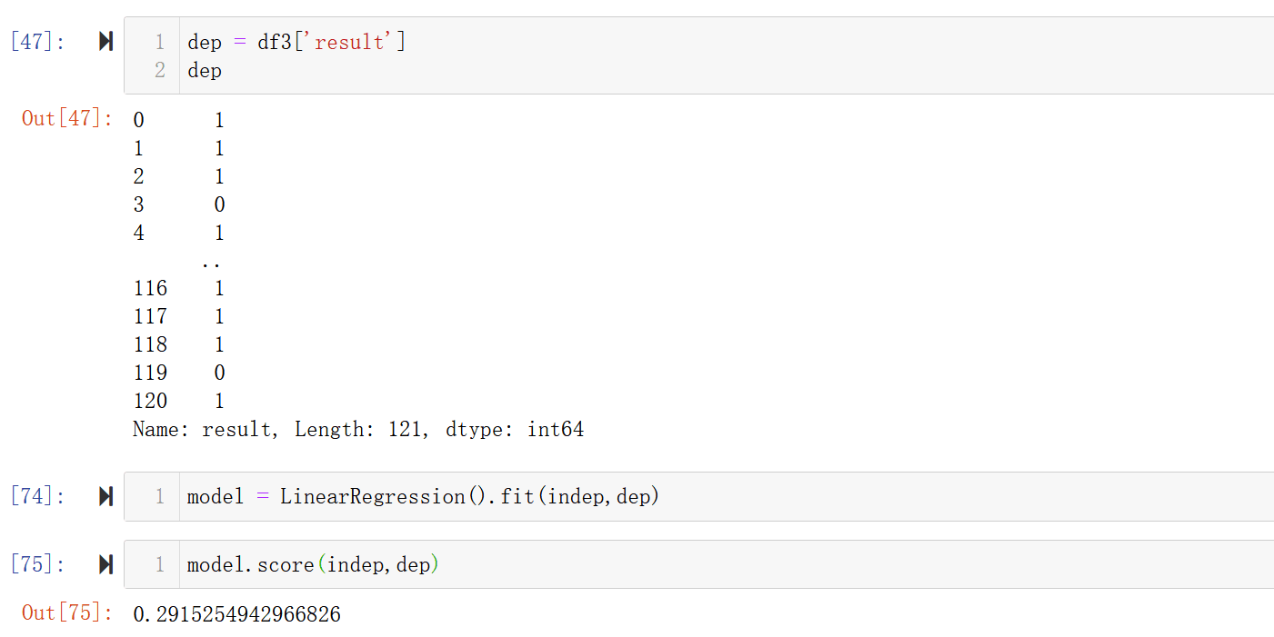
Analysis and Models --- Linear Regression Analysis 2

Slide 17
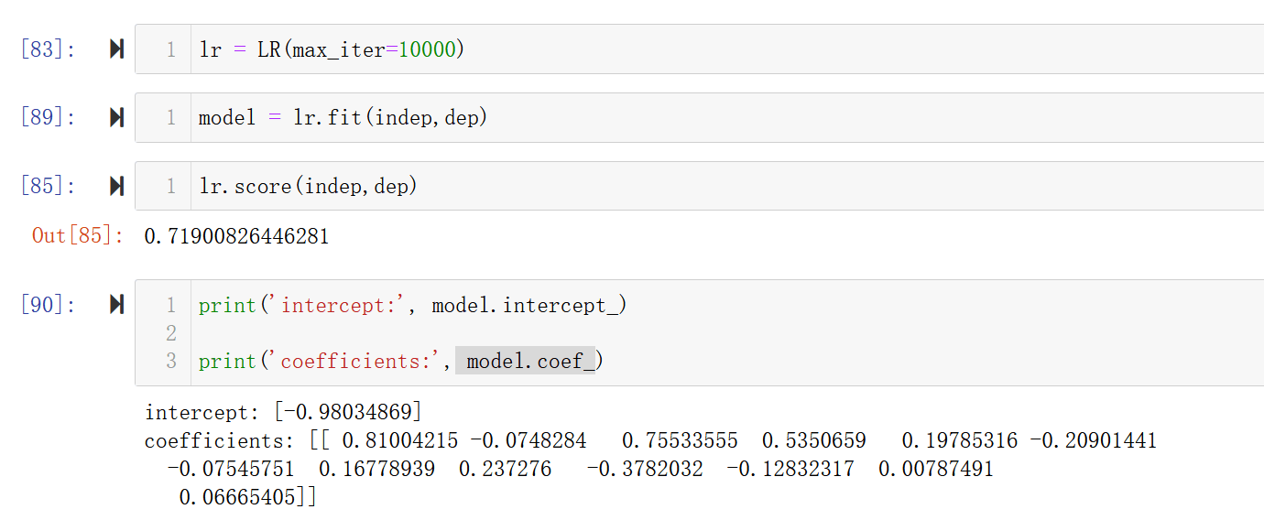
Analysis and Models --- Logistic Regression Analysis 2

Slide 18
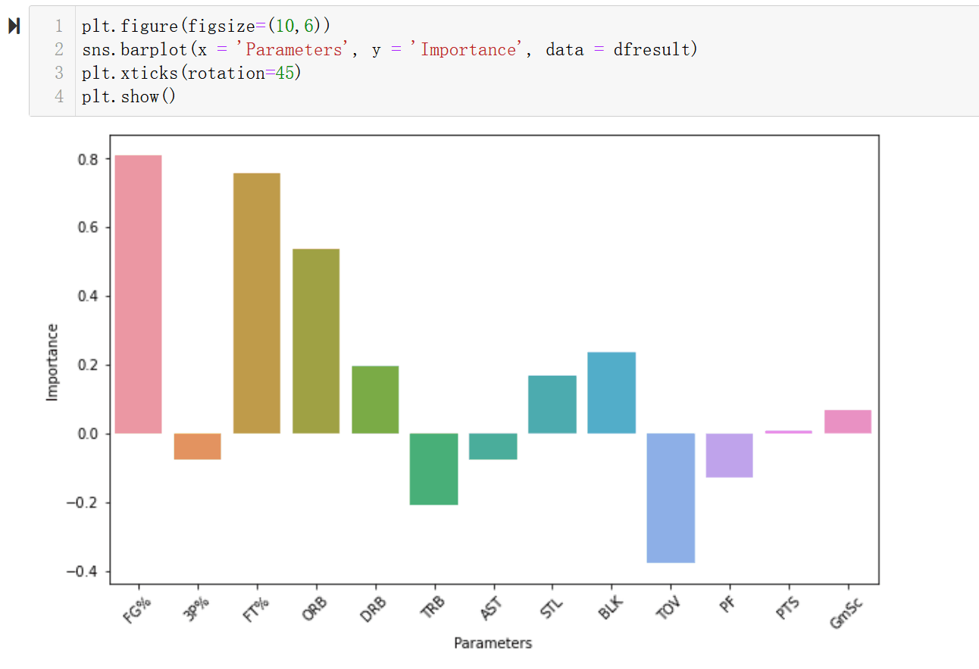
Analysis and Models --- Logistic Regression Analysis 2
The four parameters, Field Goal Percentage (FG%), free throw attempts (FT), block per game (BLK) and offensive rebounds (ORB) affect the result greatly and positively.
Turnovers per game (TOV) and total rebounds (TRB) have a negative effect on winning.

Slide 19
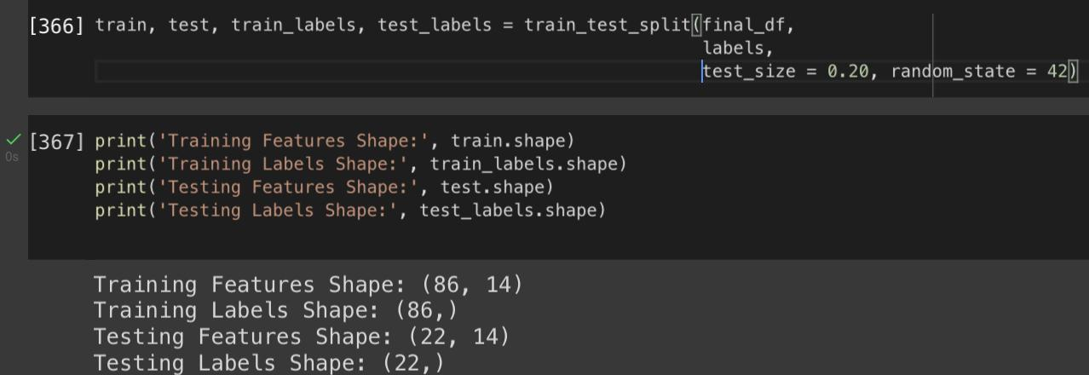
Analysis and Models - Random Forest

Slide 20
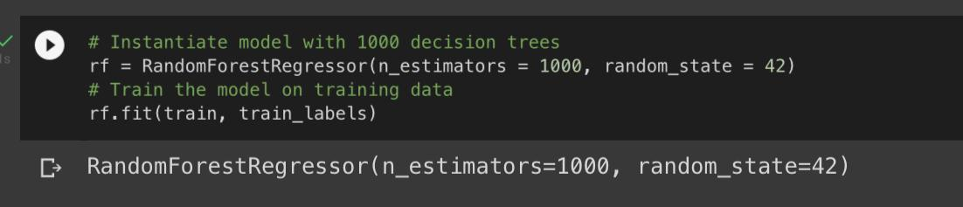
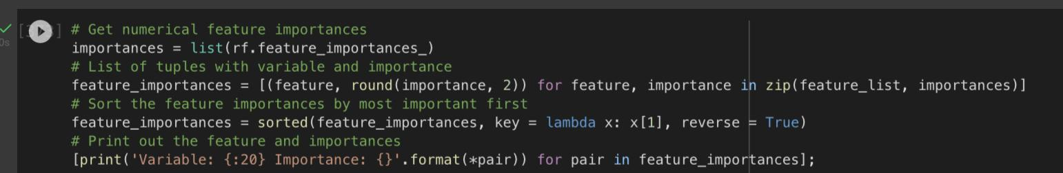
Analysis and Models - Random Forest

Slide 21
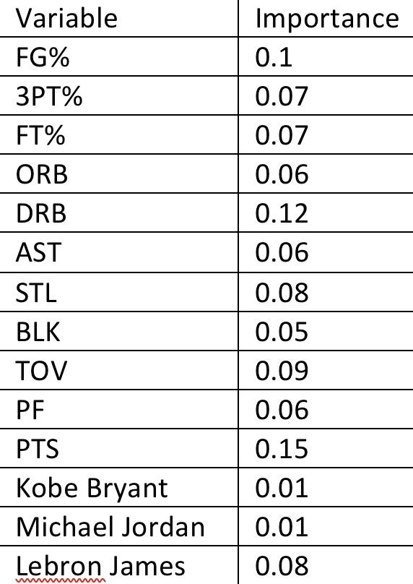
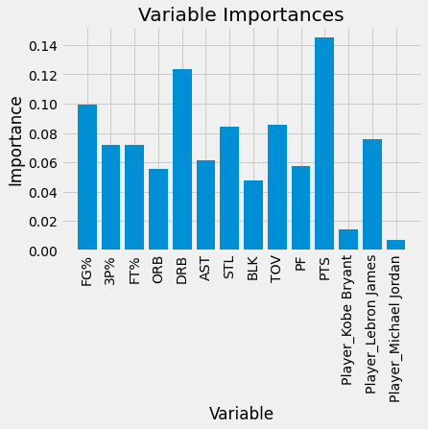
Analysis and Models - Random Forest

Slide 22
Conclusions
As we suspected, no model told us who was the “best”, which is a fairly subjective term.
One can argue the kNN model showed that Michael Jordan performed the best in his finals performances based on record but this fact is already well documented.
With respect to the statistics that have the greatest impact on determining the outcome of NBA finals games, free throw attempts, blocks, offensive rebound and field goal percentage all showed the highest significance in the linear regression model.
The random forest model put more emphasis on points overall and defensive rebounds.

Slide 23
Thank you!

Slide 24
References: https://www.kaggle.com/xvivancos/michael-jordan-kobe-bryant-and-lebron-james-stats/code https://www.kaggle.com/brunovinicius154/who-is-the-best-mj-lb-kobe-eda 2

